Slide 1
Subway Crimes
R Exploratory Data Analysis
Hyejin Kim

Slide 2
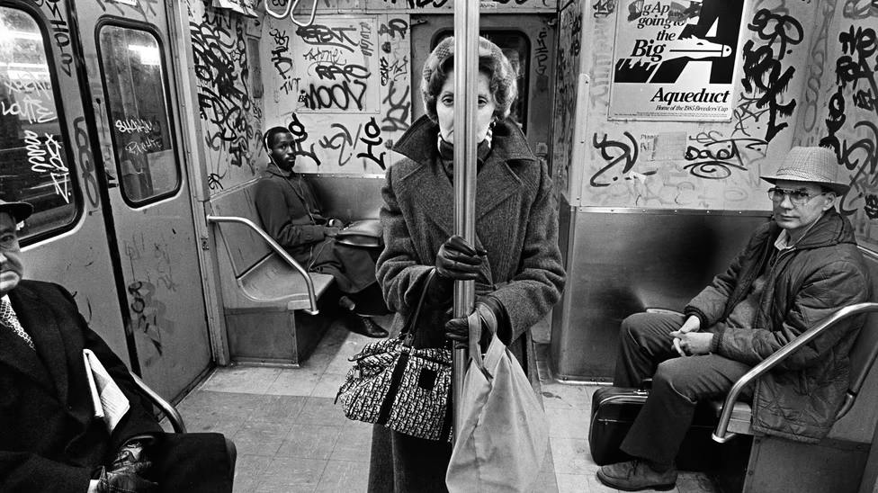
“NYC ends 2021 with uptick in violent crime in subways”
NYdailynews.com January 22, 2022
“NYC subway crime surging”
NYpost.com April 16, 2022
“Alarming increase in transit crimes”
abc7ny.com March 2, 2022
Richard Sandler
Notes:
If you follow the news, you’ve probably seen many headlines warning that crime is surging on the NYC subway. Here are just three headlines from the past couple months. [read headlines on slide].
I wanted to look into the data to see how much is crime actually on the rise, or whether these headlines are just fear mongering. I also wanted to see what other interesting trends that I could see in the data.
.

Slide 3
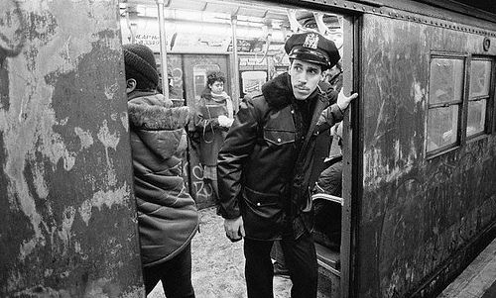
Datasets:
NYPD Complaint Data (2 tables)
MTA Daily Ridership Data (3 tables)
Richard Sandler
Notes:
I used two different datasets for my analyses.
The first is the NYPD Complaint dataset. This includes all valid felony, misdemeanor, and violation crimes reported to the New York City Police Department (NYPD)
The second is the MTA Daily Ridership dataset. This has data on all passengers who enter the subway system.

Slide 4
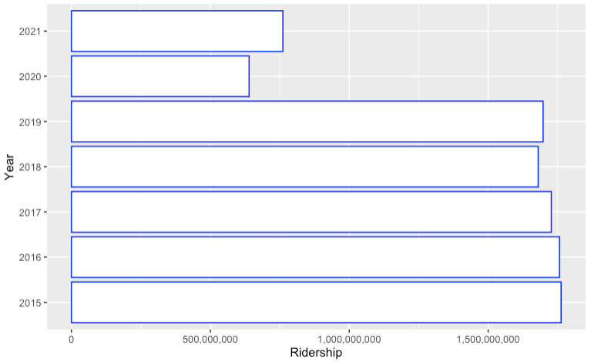
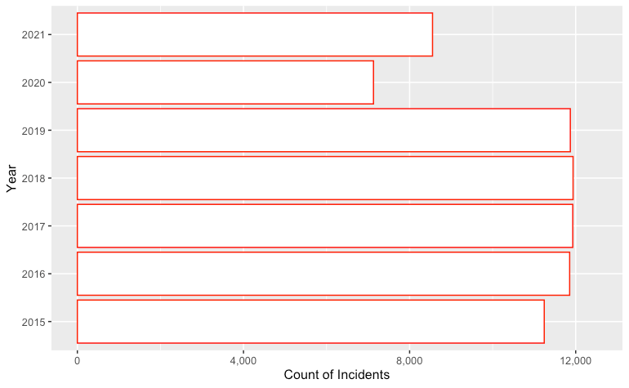
Annual total subway ridership Annual subway incident reported
Notes:
First, I wanted to see whether crime is actually up on the subways.
To begin my analysis, I realized that I had to account for the fact that ridership on the subway is way down due to the pandemic. The chart on the left shows ridership numbers on the subway from 2015 through 2021. As you can see, ridership numbers in 2020 and 2021 were way down.
The chart on the right shows the number of crimes reported on the subway during that same time period, 2015-2021. Now, the number of crimes reported in 2020 and 2021 were lower than in prior years. But what I thought was interesting from these charts was that crime during the pandemic did not seem to drop as much as ridership. Just eyeballing it here, if you look at the chart on the left, ridership in 2020 dropped about 60% from 2019. But if you look at crime in the same time period, it only dropped by about 40%. So if you think about the amount of crime per rider, it’s apparent that crime has gone up during the pandemic.
I explored that more on the next slide.

Slide 5
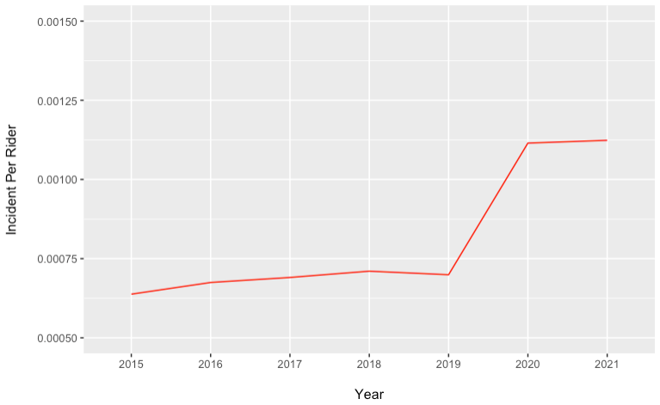
Incident per ridership (2015-2021)
Notes:
The Y axis on this chart shows crime numbers per rider. The X axis shows the years from 2015 to 2021.
As you can see, crime per rider has increased significantly during the pandemic. In fact, it has increased about 60%. That’s consistent with what we saw on the prior slide. Basically, while ridership numbers plummeted during the pandemic, crime numbers did not go down nearly as much.

Slide 6
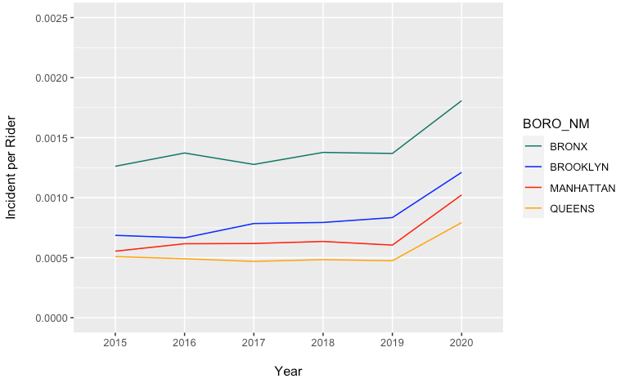
Incident per ridership per borough
Notes:
And when breaking out the view per borough, we see that all four subway boroughs have experienced this uptick similarly
(2021 breakout by borough data not available)

Slide 7
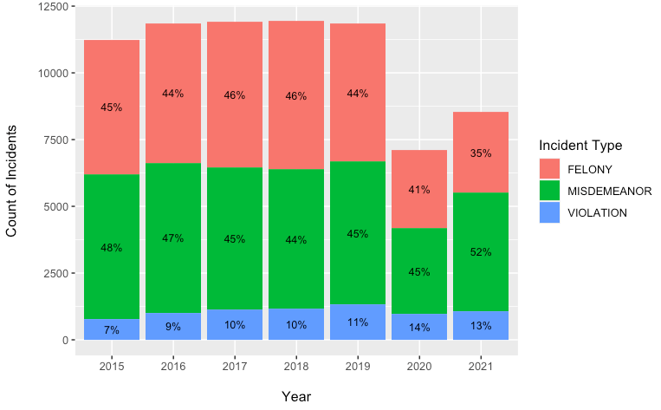
Distribution of level of crimes per year per total volume
Notes:
Given all of the tragic stories reported in the news, I was curious to see if there was a particular increase in serious crimes. This chart is the same annual count of incidents reported per year from earlier but now with distribution of incident type within a given year.
To my relief, it looks like the distribution of felonies (which are classified as most serious/dangerous) have actually gone down slightly in the past 2 years, with higher distribution towards misdemeanors in 2021 compared to all other years.
Top 5 crimes: Criminal mischief, grand larceny, Assault, Harassment, Forgery

Slide 8
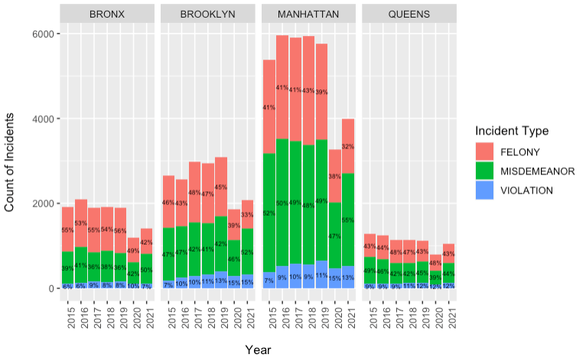
Distribution of level of crimes per year per total volume / For each borough
Notes:
And again, breaking out for each borough - we see similar trends happening across all 4 with less distribution for felonies in the post covid years with slight increase in distribution for misdemeanors.

Slide 9
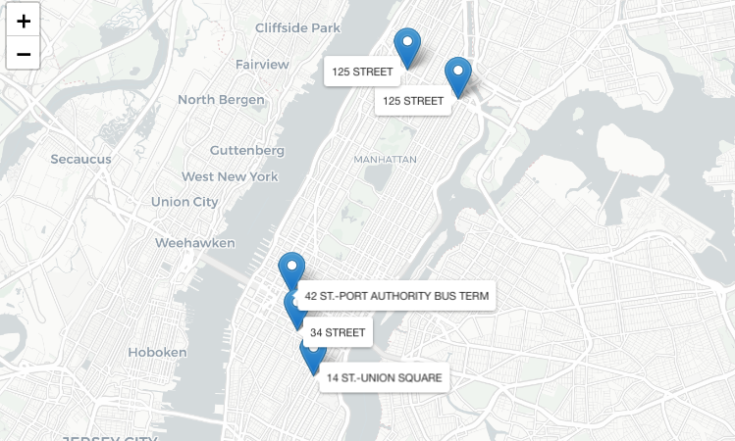
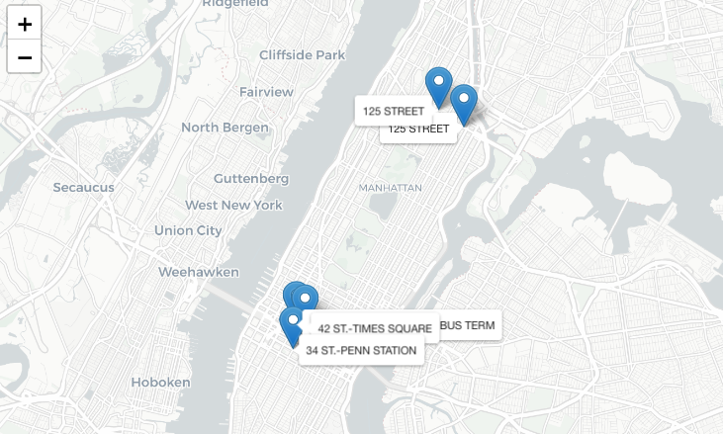
Top 5 stations with most reported incidents
Pre COVID (2019) Post COVID (2021)
Notes:
Which stations have the most incidents? Was there a difference pre and post pandemic?
I was curious to see where the most incidents happen and if there was a change at all in terms of location post covid. For the most part, there did not seem to be drastic differences, 125th st subway up north and the larger stations around 34th and Times Square were consistently on the top of the list for each year.

Slide 10
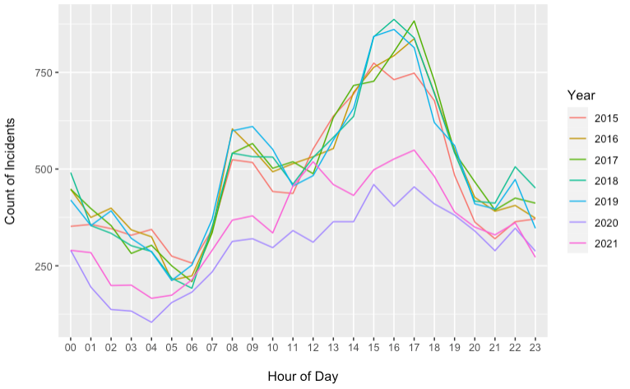
Number of incidents over the course of a day (2015-2021)
Notes:
What about the differences in time of day when subway incidents occur?
When looking at the number of incidents over the course of a day, we notice spikes during the morning and afternoon rush hours.
What was interesting to me was that there was relatively low activity during the late evenings (which is when one would assume more crimes happen) but when we’re thinking about total volume, it would make sense since there are significantly less people that take the subways during these late night hours.
It seems like there are peaks of incidents during the morning & evening rush hours between the times from 8am-9am and then from 3pm-5pm. Again, this makes sense when we’re talking about total count of incidents and there are just more bodies in the subway during these times.
When we look at the differences amongst the years, it's also worth pointing out that there does not seem to be big differences in number of incidents precovid and post covid in late night hours (even though ridership was significantly lower in 2020, 2021 as we saw in the earlier slides). We do see larger gap in volume differences during rush hour.

Slide 11
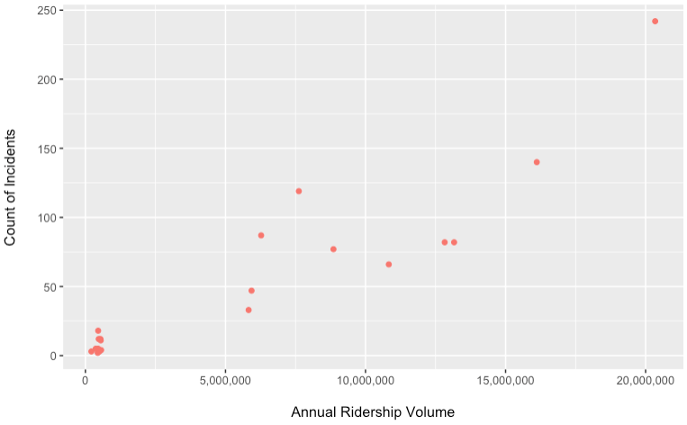
Busier subways = higher likelihood of incidents?
Number of incidents and Ridership Volume
Notes:
So the plots from prior slide seem to suggest that most crimes happen the busier the subway is… more crimes seem to happen during peak hours when there are more bodies in the stations and the stations that had the highest report like times square/penn station/port authority were all major hubs that are quite busy. So, is that true? Is the fact that a station has more bodies always mean there will be higher likelihood of crime incidents? Perhaps crowdedness and hectic environments induce more crime?
This chart shows the raw counts of incidents for 10 of the busiest and 10 of the least busiest subways, as expected there are more incidents on busier subways

Slide 12
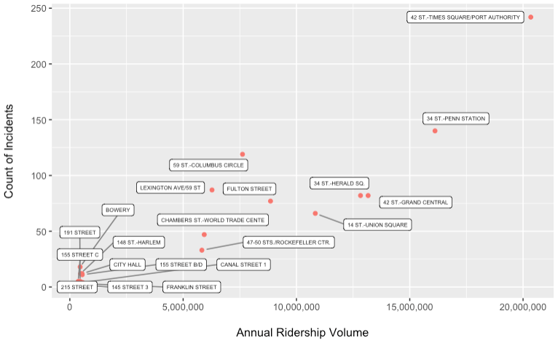
Busier subways = higher likelihood of incidents?
Number of incidents and Ridership Volume
Notes:
So the plots from prior slide seem to suggest that most crimes happen in busier subways… more crimes seem to happen during peak hours when there are more bodies in the stations and the stations that had the highest report like times square/penn station/port authority were all major hubs that are quite busy. So, is that true? Is the fact that a station has more bodies more likely to have more crime?
This chart shows the raw counts of incidents for 10 of the busiest and 10 of the least busiest subways, as expected there are more incidents on busier subways

Slide 13
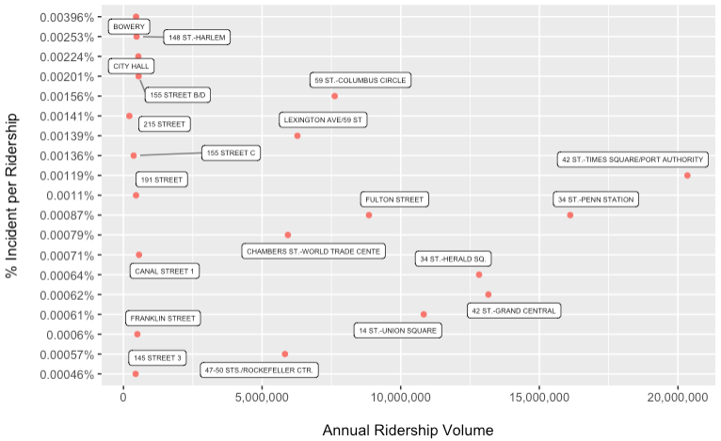
Busier subways = higher likelihood of incidents?
% Incident per Rider and Ridership Volume
Notes:
But when we plot the % of Incident per Rider across Ridership Volume, we see that there’s less of a relationship, especially in the samples of low annual volume stations there wide variability among the rate of incidents per rider.
So it’s pretty clear that there are several other factors that contribute to incident rate such as overall crime rates for a given area the stations are within, maybe the presence of police activity, socioeconomic factors of the neighorhood the station is located

Slide 14
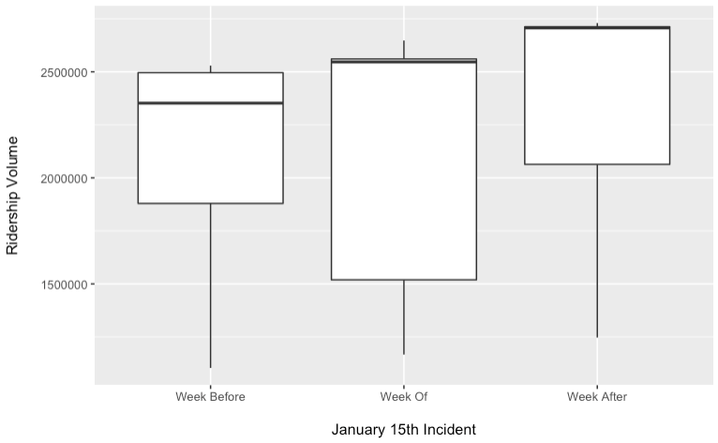
Recent subway incidents in the headlines
January 15, 2022 - Michelle Go
Notes:
Lastly, I was curious to see how much of an impact big events that made news across media headlines had on New Yorkers and if these terrible incidents affected their commuting behaviors in any way.
One of those tragic events took place back in January, when a young woman was pushed into the tracks onto an upcoming train. I know I was personally shaken up when I heard about this news, but how much impact did it have on other New Yorkers?
The figure on the left is the range of daily ridership the week prior to the incident, with the middle showing the week of, then finally the last showing the week after.
The plots here show possible indication that there was an effect, with the 25th percentile stretching further down to lower daily volumes.
The median is actually higher, in fact both the distribution of median to 75th are higher and concentrated above. While the news was horrifying and terribly tragic - but, it seems like for the most part, this incident didn’t have a large effect. And this makes sense as the subway is often the only accessible and affordable mode of transportation to a lot of people and perhaps a singular random event would not be enough to deter most people from changing their behavior in any drastic way.

Slide 15
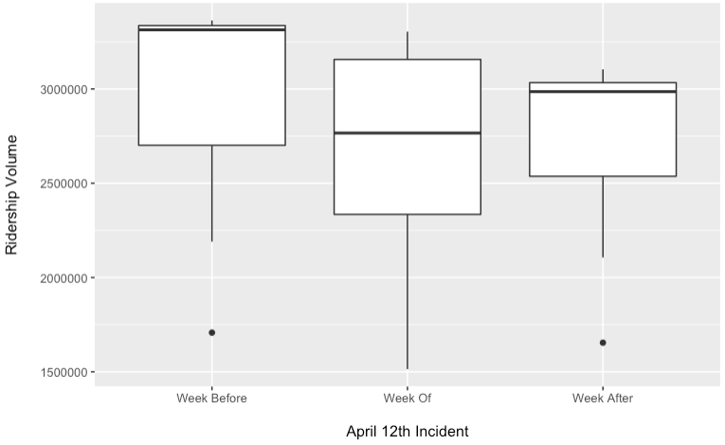
Recent subway incidents in the headlines
April 12, 2022 - Frank James Subway shooting
Notes:
The next event unfortunately took place not too long ago, and a lot of you here know it well - we were all in class when the news broke out and probably were receiving texts from friends and family checking in on us when just about a month ago there was a shooting in the sunset park brooklyn station.
And while thankfully, there were no fatalities during this event - it appears that this had a bigger impact on New Yorkers based on the dip in ridership the week of the event. This incident was at a larger scale and considered a terror attack and seems to have had an effect on ridership.
The median during the week of is lower in addition to a lower 25th percentile along with a longer tail towards the lower end of the volume as opposed to the week before and after. The lower range is shorter with 1 outliers each (the outlier here were both sundays).

Slide 16
Summary:
Subways crime rates have increased with ridership volume at all time lows
Busier stations do not necessarily equal higher crime rates
Significant crime incidents seem to affect ridership volume in the short term
Next Steps:
Expand charts to include more data points to see full scope
Incorporate statistical methods
Explore other variables that may contribute to subway crime
Police Activity
Increase in homeless population encampments
Socioeconomic factors of neighborhoods
Notes:
During the pandemic, while ridership was at an all time low, there was also an increase in homeless population setting up encampments in the subways and even on the tracks, with this increase there has also been increases in incidents related to mental health episodes, intoxication, and public endangerments

